Slide 1







Analysis of Global Tech Trends
Rorisang Sitoboli
August 2021

Slide 2



OUTLINE
Executive Summary
Introduction
Methodology
Results
Visualization – Charts
Dashboard
Discussion
Findings & Implications
Conclusion
Appendix

Slide 3

EXECUTIVE SUMMARY
This document will present findings on the following
Programming languages
Current usage
Future usage
Demographics
Databases
Global trends
Gender gaps

Slide 4

INTRODUCTION
Analysis of tech/software trends
ID current popular skills
ID tech shift in the short-term future
Web frameworks popularity
Software engineering platform popularity

Slide 5

METHODOLOGY
Data was collected from sources such as
Stack Overflow Developer (2019),
GitHub job postings,
Programming languages annual salaries
Data was in different formats:
.csv
.xlsx
EDA was conducted initially followed by the usual suite:
Data cleaning
Data visualization
Analysis tools
Python (Anaconda distribution)
Excel
IBM Cognos Analytics

Slide 6
RESULTS
The results from all the datasets are presented in the next section.
The trends are backed up by both visual and numerical evidence.
The analysis is predominantly on:
Programming languages
Databases
Frameworks
Demographics (gender)

Slide 7
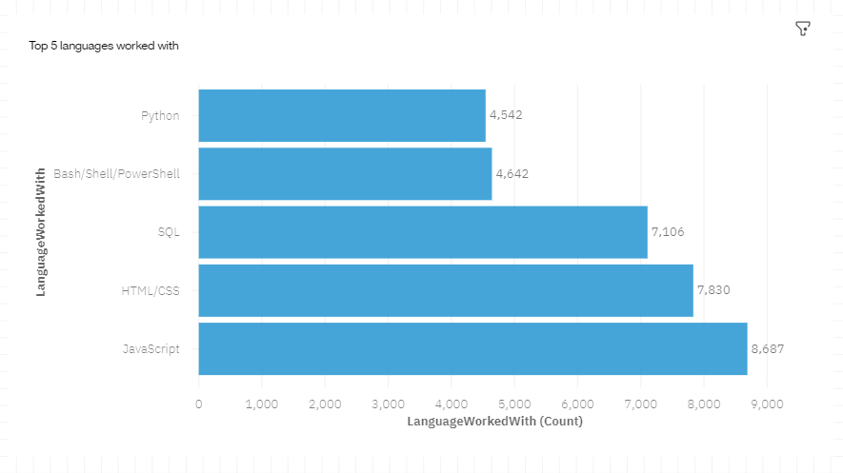
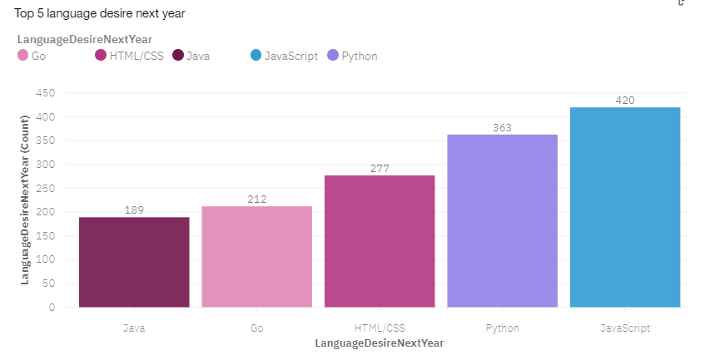
PROGRAMMING LANGUAGE TRENDS
Current Year
Next Year

Slide 8
PROGRAMMING LANGUAGE TRENDS - FINDINGS & IMPLICATIONS
Findings
JS, HTML/CSS are currently the most popular
Python and Java are more popular than C++
SQL programming is currently very popular
Implications
Web development skills are in high demand
Python-related tasks such as Big Data analysis and AI are driving this trend. Java is mostly software in devices
Scripting languages will become more popular

Slide 9
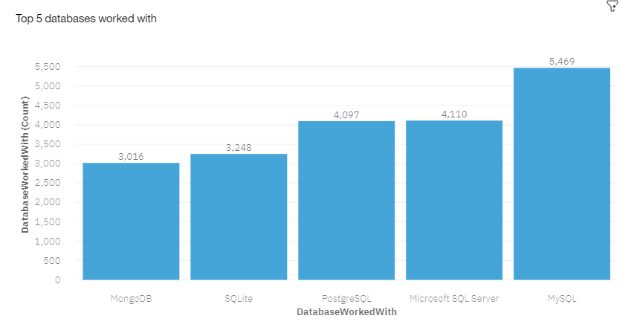
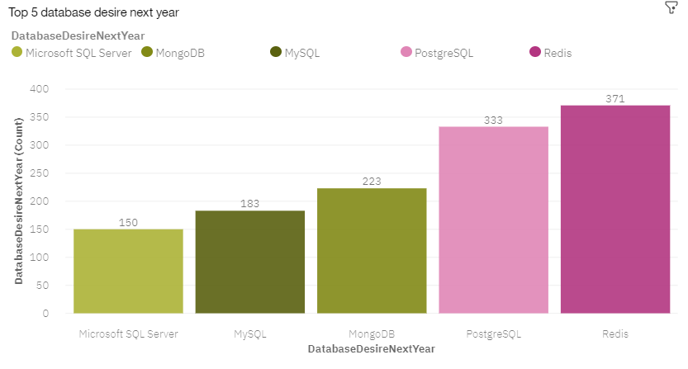
DATABASE TRENDS
Current Year
Next Year

Slide 10
DATABASE TRENDS - FINDINGS & IMPLICATIONS
Findings
SQL based databases are very popular
MongoDB and Redis are growing in popularity
PostgreSQL still very popular
Implications
Workforce in data engineering needs to upskill
Companies need to plan to migrate to using these databases
Open-source databases and software will eventually be more commonplace

Slide 11

DASHBOARD
https://dataplatform.cloud.ibm.com/dashboards/8d0681de-0c97-4d27-a150-161faeb40910/view/5264c13605b523e151f7b1e4079179057b33730cb0bbd10189d17b495b677897a96010c0c87c425ade44036afbee175ccd

Slide 12
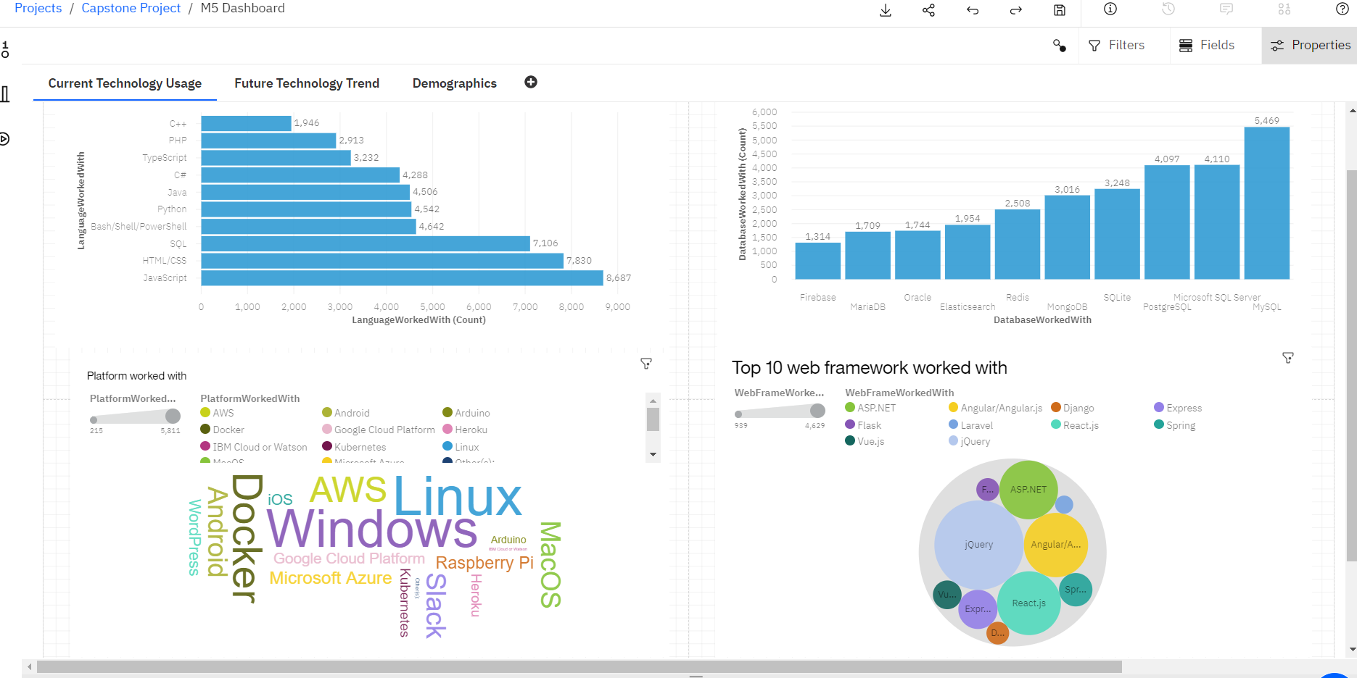
DASHBOARD TAB 1: CURRENT TECH USAGE

Slide 13
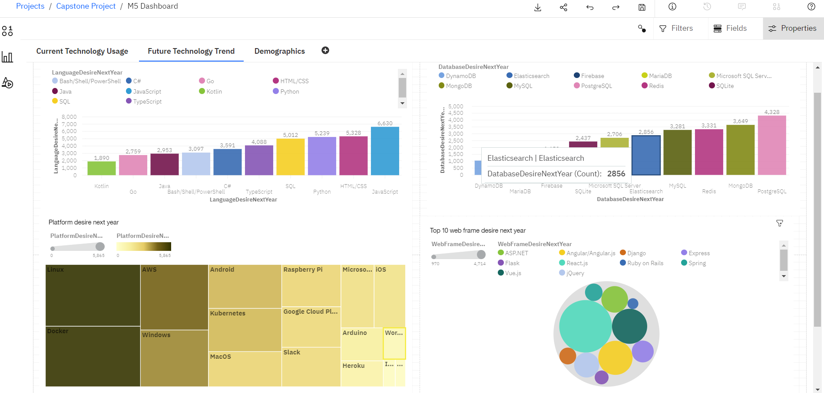
DASHBOARD TAB 2: FUTURE TECH TREND

Slide 14
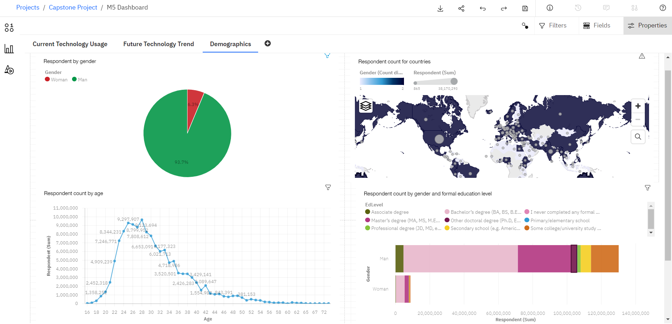
DASHBOARD TAB 3 : DEMOGRAPHICS

Slide 15
DISCUSSION
Current trends:
Web development languages top
C++ way behind Python and Java
SQL-based databases are the most popular
Windows and Linux are currently the extensively used platforms
Docker more popular than Kubernetes
Jquery is the most popular web framework

Slide 16
DISCUSSION
Future trends:
Web development languages still top-JS and HTML/CSS
Python and Java still among top 10 desirable-C++ not in
SQL-based databases still most desirable skills
Docker and Linux significantly more popular than Windows
Docker far more in demand than Kubernetes
React.js the framework of the future

Slide 17
DISCUSSION
Demographics:
Tech and software has biased presentation
Significantly more men than woman (87 percentage points more!)
Breakdown by country (global analysis) shows the same bias
Americas and Eastern Europe are heavily represented
Age range: 16-54.
Most tech developers are btwn 23-30
Majority of the either gender have Bachelor’s
Followed by ‘no formal education’ respondents

Slide 18
OVERALL FINDINGS & IMPLICATIONS
Findings
Tech sector is very dynamic
Huge gender gap
New tech like Docker and Linux gaining huge traction
Implications
Stakeholders need to be flexible
Such findings need to be made available to motivate relevant change
Workforce needs to upskill

Slide 19

CONCLUSION
Companies and workforce need to adapt to and adopt innovation early
This will help lower unemployment as areas that need development will ID early
Globally, a cultural change is needed wrt female representation in tech and software
Point 4

Slide 20

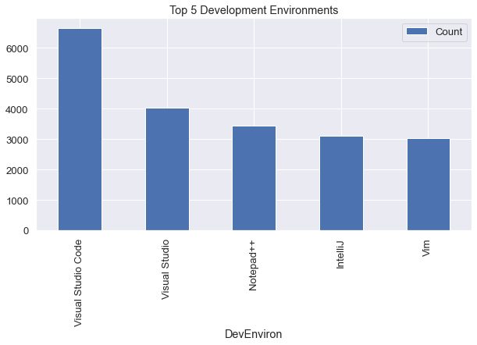
APPENDIX

Slide 21
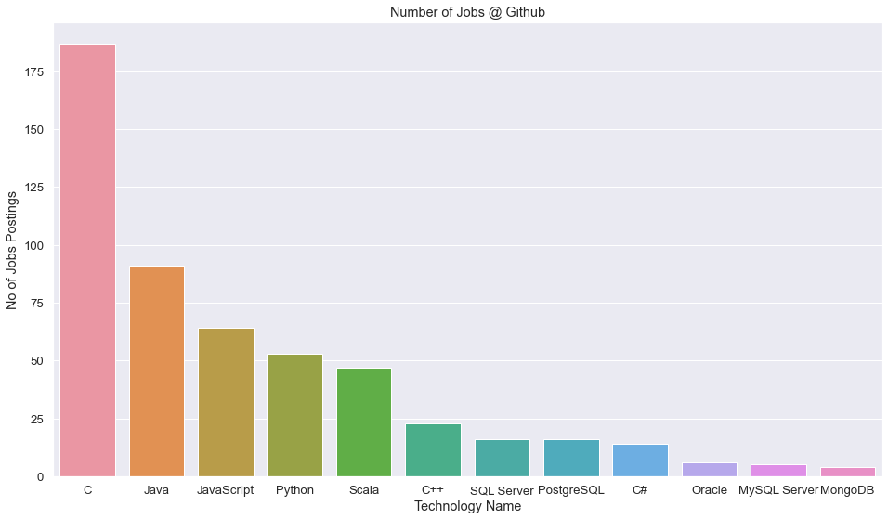
GITHUB JOB POSTINGS

Slide 22
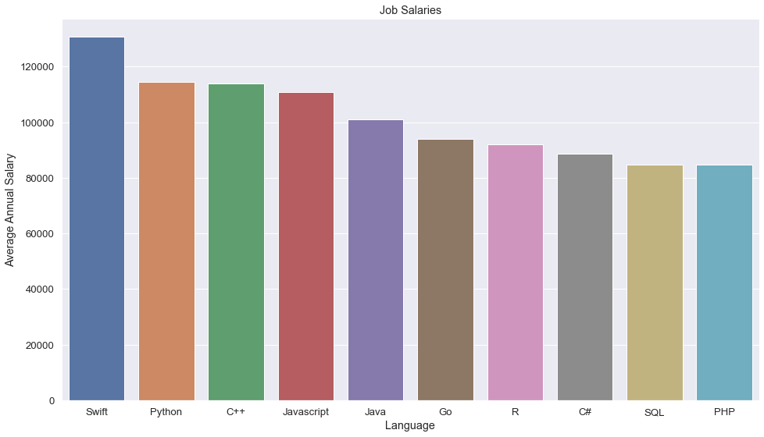
POPULAR LANGUAGES

